Slide 2
Machine Learning in Drupal with TensorFlow.js
Rick Torzynski
Senior Drupal Developer, ECS
Esteemed
Github: https://github.com/ricktorzynski/drupalcon-europe-tensorflowjs

Slide 3



My Development History
I've been a Drupal Developer for 12 years, working on government agency Drupal websites,
healthcare Drupal websites, machine learning applications, and software engineering.
Senior Drupal Developer
Drupal Developer at Florida Blue
Senior Software Developer

Slide 4
Our Agenda
Intro to Machine Learning
What is Deep Learning?
What is TensorFlow.js?
Drupal and Machine Learning
Understanding the Component Module
Demo
Looking to the Future
Questions?

Slide 5

Intro to Machine Learning
"Just as electricity transformed almost everything 100 years ago, today I actually have a hard time thinking of any industry that I don't think AI will transform in the next several years."
Andrew Ng - Stanford Professor & Co-founder of Coursera

Slide 6




Intro to Machine Learning
Companies currently leveraging machine learning applications and devices
Nvidia
Facebook
Tesla
LinkedIn
GPUs
Edge Devices
Omniverse
Face Recognition
Friend Recommender
PyTorch
Self Driving Cars
Robots
Job Search
Networking
Others: Amazon, Banks (credit card fraud), Airports (facial recognition), Ebay, etc...

Slide 7

Intro to Machine Learning
"Machine learning focuses on applications that learn from experience and improve their decision-making or predictive accuracy over time." - IBM

Slide 8
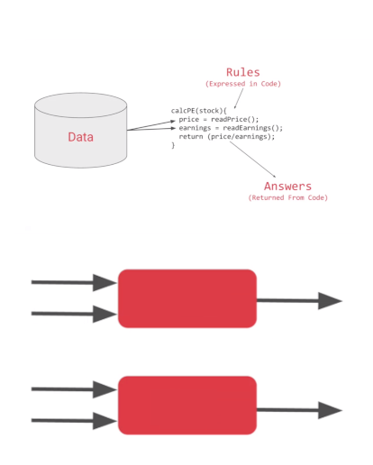
Intro to Machine Learning
Types of Machine Learning
Supervised Learning - for a set of data, the outcome is known (linear regression, classification)
Unsupervised Learning - outcome unknown, but interested in how data clusters together into groups (PCA, Recommender)
Programming Paridigm
Traditional Programming
Rules + Data -> Answers
Machine Learning
Answers + Data -> Rules
Rules
Traditional
Programming
Answers
Data
Answers
Data
Machine
Learning
Rules
Diagram: Moroney, L. (2021). AI and Machine Learning for Coders: A Programmer’s Guide to Artificial Intelligence. O’Reilly.

Slide 9
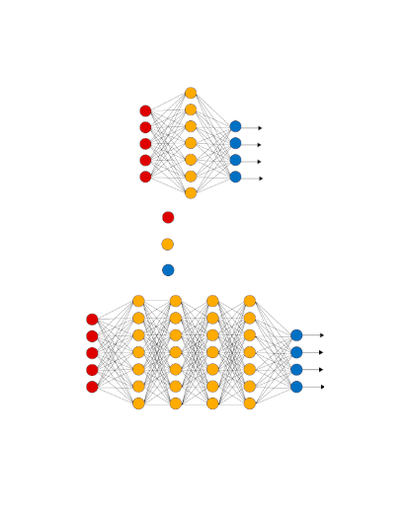
What is Deep Learning?
“A subfield of machine learning concerned with algorithms inspired by the structure and function of the brain called artificial neural networks.”
Input Layer
Input Layer - Images, text, audio, video, numbers, etc. Must be quantifiable.
Hidden Layers - Filters for feature extraction
Output Layer - Classification, prediction
Activation function - takes in the output signal from the previous cell and converts it into some form that can be taken as input to the next cell.
Sigmoid, ReLU and Softmax
Hidden Layer
Output Layer

Slide 10
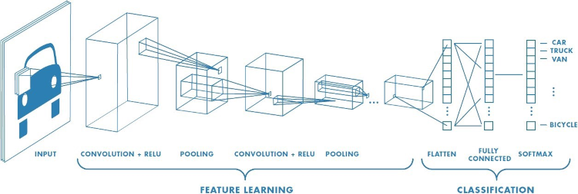
What is Deep Learning?
Convolutional Neural Network

Slide 11
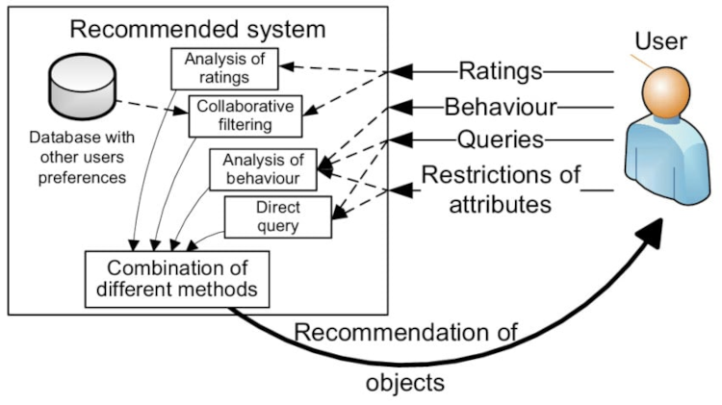
What is Deep Learning?
Recommendation Engine using Machine Learning

Slide 12
What is TensorFlow.js?
Language most used for ML: Python
High level language very similar to PHP - Pip/Composer
Dependencies: Numpy, Scipy, Scikit-learn, Pandas, Matplotlib, Keras, TensorFlow, PyTorch
Jupyter Notebooks/Google Collab: interactive in-browser editor
Integrated Development Environments - Visual Studio Code, PyCharm, Atom
Other Languages used
R, Java, C++, Julia and JavaScript

Slide 13
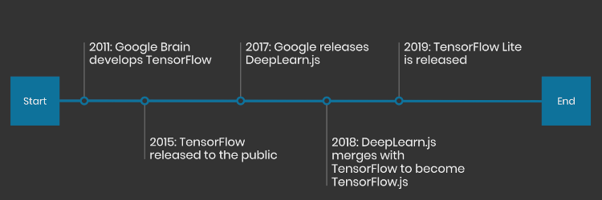
What is TensorFlow.js?
Brief History of TensorFlow.js

Slide 14

Drupal and Machine Learning
3 Machine Learning modules:
Machine Learning Libraries
Drupal Compute
Recommender API
Drupal 7 only
Allows use of Python or Java code using Drupal queue
Proprietary Machine Learning functionality
Acquia - Personalization

Slide 15

Drupal and Machine Learning
An alternative: Component Module + TensorFlow.js
Component Module
Use JavaScript within a block
JavaScript configuration in block config
Drupal setup to work with JavaScript
TensorFlow.js
Fully developed JavaScript library
Uses WebGL to access GPU for processing
TensorFlow Datasets - Collection of datasets
TensorFlow Hub - Collection of pre-trained models
Models developed in Python can be converted to TensorFlow.js models

Slide 16
Understanding the Component Module
Directory Structure
/web/modules/custom/tensorflow
.../tensorflow/tensorflow.info.yml
.../tensorflow/components
.../tensorflow/components/comp_linear_reg/comp_linear_reg.component.yml
.../tensorflow/components/comp_linear_reg/index.html
.../tensorflow/components/comp_linear_reg/tf_linear_reg.js
Creating Custom Component Module
Create tensorflow.info.yml file
Create comp_linear_reg.component.yml
Create tf_linear_reg.js
Create index.html
Adding Component Block to Page
Add TensorFlow.js Linear Regression Block to Content Region
Configure Block
Clear Cache

Slide 17
DEMO TIME!

Slide 18
Looking to the Future
Work on TensorFlow.js Module
AI Chatbot for Drupal
Recommender for Drupal Commerce
Job Recommender

Slide 19
QUESTIONS?

Slide 20
Thank You!
For all who attended my talk
DrupalCon Europe Organizers and Volunteers
Matt Ellis Pritchard of Esteemed
My Colleagues at Esteemed
And Most of All I Thank God

Slide 21
Join us for
contribution opportunities
4-7 October, 2021
Online on https://drupalcontributions.opensocial.site/
Mentored
Contribution
First Time
Contributor Workshop
General
Contribution
7th of October: 14:00 - 17:00
5th of October: 14:00 - 17:00
4th of October: 9:00 - 12:00
5th of October: 14:00 - 17:00
6th of October: 9:00 - 12:00
7th of October: 14:00 - 17:00
#DrupalContributions

Slide 22

What did you think?
Locate this session at the DrupalCon Europe 2021 website
and take the survey for each session:
https://events.drupal.org/europe2021/schedule/all

